Slide 1
OSLC Capability Support
Martin Ulrich, BD/PLM5, 19.01.2023

Slide 2
Relevant capabilities (excerpt)
OSLC Capability Support
Product Management
Engineering Management
Product Portfolio Management
System Engineering Management
Product Variant Management
Product Classification Management
System Req. Management
System Architecture Management
Product Version Management
Product Configuration Management
SW Engineering Management
Product (CI)
Identification Management
CI Branch
Management
xxx Traceability Management
CI Control Management
CI Baseline Management
xxx Consistency Management
CI Status Management
See notes for details
CI – Configuration Item
Notes:
Product Management
Ability to plan, organize, and control all tasks, which aim at a successful conception, provisioning, and marketing of individual products as well as overall product portfolio offered by a company. Product may refer to good, service, solution, system and system domains (e.g. software, mechanics, electronics).
Product Portfolio Management
Ability to generate and maintain a complete overview of all the products. This includes to review the entire portfolio from budding ideas to products that need to be retired for strategic alignment and brand impact.
Product Variant Management
Ability to administer product configurations that are offered as individual products and their interdependencies.
Product Classification Management
Ability to define and maintain appropriate product hierarchies and clusters in order to provide multiple views on the product portfolio.
Product Version Management
Ability to bundle requirements/changes for products into product versions.
Product Configuration (Item) Management
Ability to establish and maintain the integrity of all work products of a process or project and make them available to affected parties.
As a result of successful implementation:
1) a configuration management strategy is developed;
2) all configuration items generated by a process or project are identified, defined and base-lined according to the configuration management strategy;
3) modifications and releases of the configuration items are controlled;
4) modifications and releases are made available to affected parties;
5) the status of the configuration items and modifications is recorded and reported;
6) the completeness and consistency of the baselines is ensured; and
7) storage of the configuration items is controlled.
[A-SPICE V3.1 SUP.8 Configuration Management]
Product /Configuration Item Identification Management
Ability to identify and document configuration items according to the configuration management strategy.
NOTE: Configuration control is typically applied for the products that are delivered to the customer, designated internal work products, acquired products, tools and other configuration items that are used in creating and describing these work products.
[A-SPICE V3.1 SUP.8.BP2 Identify configuration items] https://jazz.net/wiki/bin/view/Deployment/CLMCfgMRecommendedPractices
Configuration Item Branch Management
Ability to establish a branch management according to the configuration management strategy where applicable for parallel developments that use the same base.
[A-SPICE V3.1 SUP.8.BP4 Establish branch management]
Configuration Item Control Management
Ability to establish mechanisms for control of the configuration items according to the configuration management strategy, and control modifications and releases using these mechanisms.
[A-SPICE V3.1 SUP.8.BP5 Control modifications and releases]
Configuration Item Baseline Management
Ability to establish baselines for internal purposes and for external delivery according to the configuration management strategy.
NOTE: For baseline issues refer also to the product release process.
[A-SPICE V3.1 SUP.8.BP6 Establish baselines]
Configuration Item Status Management
Ability to record and report status of configuration items to support project management and other relevant processes.
NOTE: Regular reporting of the configuration status (e.g. how many configuration items are currently under work, checked in, tested, released, etc.) supports project management activities and dedicated project phases like software integration.
[A-SPICE V3.1 SUP.8.BP7 Report configuration status]
Engineering Management
Ability to define a functional system strategy and engineer the system and system elements. Moreover Engineering Management takes care of a close alignment with adjacent disciplines like production, logistics or customer management. It takes care of engineering related data management and quality management.
System Engineering Management Ability to elicit and manage customer and internal requirements, to define the system architecture and to integrate and test on the system level.
[A-SPICE V3.1 SYS System Management, adjusted]
System Requirement Management
Ability to transform the defined stakeholder requirements into a set of system specifications that will guide the design of the system.
As a result of successful implementation:
1) a defined set of system requirements is established;
2) system requirements are categorized and analyzed for correctness and verifiability;
3) the impact of system requirements on the operating environment is analyzed;
4) prioritization for implementing the system requirements is defined;
5) the system requirements are updated as needed;
6) consistency and bidirectional traceability are established between stakeholder requirements and system requirements;
7) the stakeholder requirements are evaluated for cost, schedule and technical impact; and
8) the system requirements are agreed and communicated to all affected parties.
[A-SPICE V3.1 SYS.2 System Requirements Analysis]
System Architecture Management
Ability to establish a system architectural design and identify which system requirements are to be allocated to which elements of the system, and to evaluate the system architectural design against defined criteria.
As a result of successful implementation:
1) a system architectural design is defined that identifies the elements of the system;
2) the system requirements are allocated to the elements of the system;
3) the interfaces of each system element are defined;
4) the dynamic behavior objectives of the system elements are defined;
5) consistency and bidirectional traceability are established between system requirements and system architectural design; and
6) the system architectural design is agreed and communicated to all affected parties.
[A-SPICE V3.1 SYS.3 System Architectural Design]
xxx Traceability Management
Ability to establish bidirectional traceability between xxx (e.g. stakeholder requirements) and yyy (e.g. system requirements). NOTE: Bidirectional traceability supports coverage, consistency and impact analysis.
[A-SPICE V3.1 SYS.2.BP6 Establish bidirectional traceability]
xxx Consistency Management
Ensure consistency between xxx (e.g. stakeholder requirements) and yyy (e.g. system requirements).
NOTE: Consistency is supported by bidirectional traceability and can be demonstrated by review records.
[A-SPICE V3.1 SYS.2.BP7 Ensure Consistency]

Slide 3







Legend
Product development project
Component
Unit of Configurability
[abstract]
Product - as engineered
Configuration Note: Config is a Work Product
Configuration Item (Contribution)
Baseline
See notes for details
Work Product
Artifact
OSLC-Terms
Notes:
Component
A unit of organization consisting of a set of version resources. For a particular versioned resource, different versions can be in different components. Components are the units of configurability, and form reusable assets or building blocks. The granularity of a component varies between servers, but typically it contains the set of resources used in some product, project, or a subdivision of such a set. The resources in a component may be of any type, or multiple types, including but not limited to types defined in various OSLC domain specifications.
Product
goods and services (including knowledge-capturing products) that result from a production process. Note 1: At Bosch, typically the term “product” is used as synonym for "tangible goods" because in the past most Bosch product offerings have been goods. Note 2: products include service offerings, tangible products (traditional goods) and intangible products (software and other licensable offerings)
Configuration Item
Item that is designated for configuration management and treated as a single entity in the configuration management process. It controls the status of a related work product
Work product
An artifact resulting from the execution of a process

Slide 4
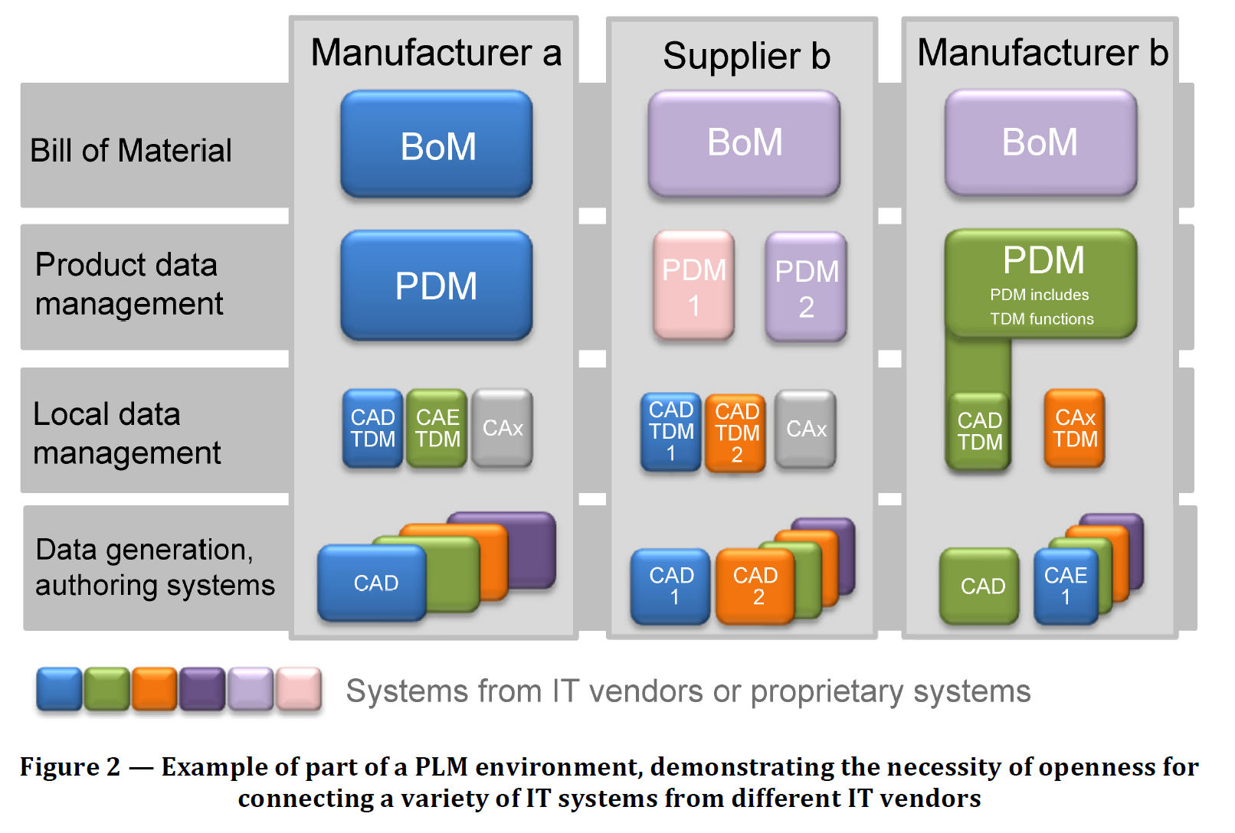
Overview of PLM environment
PLM landscape
Interpretation: BoM is more related to manufacturing BOMs in ERP
Typically effectivity controlled -> OoS for OSLC
Global Configuration Management
eBOM in PDM is typically baseline based
Local Configuration Management
e.g. Management systems for
Requirement specifications
Architecture Models
CAD Models
Electronic Models (schematics layouts)
SW
Documents
FMEA
OSLC-Terms
Source: Code of PLM Openness (DIN SPEC 91372)

Slide 5
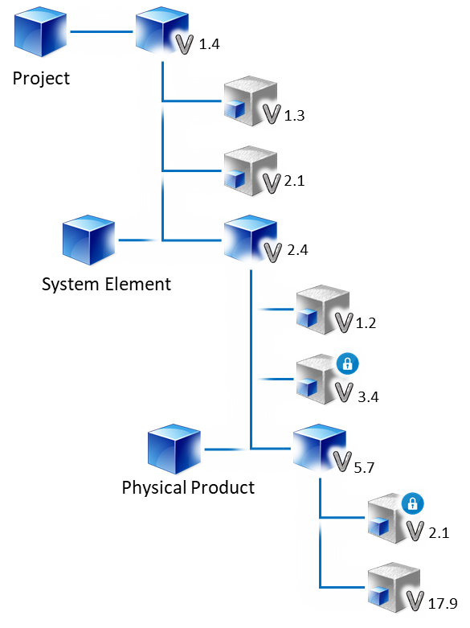
Existing OSLC Support
OSLC Capability Support
Product Management
Concepts available
Component [abstract]
Integration of two baseline-based config management systems (global and local config) via contributions
Integrate any type of workproduct to a config (eBOM)
Hierarchical Decomposition -> eBOM (Baseline-based) via contributions
Configuration-Types: Baseline, Stream, change set
Product Portfolio Management
Spec.
Product Variant Management
Product Classification Management
Product Version Management
Product Configuration Management
Product (CI)
Identification Management
CI Branch
Management
CI Control Management
CI Baseline Management
CI Status Management
CI – Configuration Item
Notes:
Product Management
Ability to plan, organize, and control all tasks, which aim at a successful conception, provisioning, and marketing of individual products as well as overall product portfolio offered by a company. Product may refer to good, service, solution, system and system domains (e.g. software, mechanics, electronics).
Product Portfolio Management
Ability to generate and maintain a complete overview of all the products. This includes to review the entire portfolio from budding ideas to products that need to be retired for strategic alignment and brand impact.
Product Variant Management
Ability to administer product configurations that are offered as individual products and their interdependencies.
Product Classification Management
Ability to define and maintain appropriate product hierarchies and clusters in order to provide multiple views on the product portfolio.
Product Version Management
Ability to bundle requirements/changes for products into product versions.
Product Configuration (Item) Management
Ability to establish and maintain the integrity of all work products of a process or project and make them available to affected parties.
As a result of successful implementation:
1) a configuration management strategy is developed;
2) all configuration items generated by a process or project are identified, defined and base-lined according to the configuration management strategy;
3) modifications and releases of the configuration items are controlled;
4) modifications and releases are made available to affected parties;
5) the status of the configuration items and modifications is recorded and reported;
6) the completeness and consistency of the baselines is ensured; and
7) storage of the configuration items is controlled.
[A-SPICE V3.1 SUP.8 Configuration Management]
Product /Configuration Item Identification Management
Ability to identify and document configuration items according to the configuration management strategy.
NOTE: Configuration control is typically applied for the products that are delivered to the customer, designated internal work products, acquired products, tools and other configuration items that are used in creating and describing these work products.
[A-SPICE V3.1 SUP.8.BP2 Identify configuration items] https://jazz.net/wiki/bin/view/Deployment/CLMCfgMRecommendedPractices
Configuration Item Branch Management
Ability to establish a branch management according to the configuration management strategy where applicable for parallel developments that use the same base.
[A-SPICE V3.1 SUP.8.BP4 Establish branch management]
Configuration Item Control Management
Ability to establish mechanisms for control of the configuration items according to the configuration management strategy, and control modifications and releases using these mechanisms.
[A-SPICE V3.1 SUP.8.BP5 Control modifications and releases]
Configuration Item Baseline Management
Ability to establish baselines for internal purposes and for external delivery according to the configuration management strategy.
NOTE: For baseline issues refer also to the product release process.
[A-SPICE V3.1 SUP.8.BP6 Establish baselines]
Configuration Item Status Management
Ability to record and report status of configuration items to support project management and other relevant processes.
NOTE: Regular reporting of the configuration status (e.g. how many configuration items are currently under work, checked in, tested, released, etc.) supports project management activities and dedicated project phases like software integration.
[A-SPICE V3.1 SUP.8.BP7 Report configuration status]

Slide 6
Existing OSLC Support
OSLC Capability Support
Engineering Management
Concepts available
OSLC RM
OSLC AM
OSLC Core
OSLC Config Management Concept- & Version-Resources (enabler for config-aware-links) Selections for local configs (enabler for Link Index)
Upcoming concepts
Link Index -> reverse-Link -> bidirectional traceability
Link Validity
System Engineering Management
System Req. Management
System Architecture Management
SW Engineering Management
xxx Traceability Management
xxx Consistency Management
Notes:
Engineering Management
Ability to define a functional system strategy and engineer the system and system elements. Moreover Engineering Management takes care of a close alignment with adjacent disciplines like production, logistics or customer management. It takes care of engineering related data management and quality management.
System Engineering Management Ability to elicit and manage customer and internal requirements, to define the system architecture and to integrate and test on the system level.
[A-SPICE V3.1 SYS System Management, adjusted]
System Requirement Management
Ability to transform the defined stakeholder requirements into a set of system specifications that will guide the design of the system.
As a result of successful implementation:
1) a defined set of system requirements is established;
2) system requirements are categorized and analyzed for correctness and verifiability;
3) the impact of system requirements on the operating environment is analyzed;
4) prioritization for implementing the system requirements is defined;
5) the system requirements are updated as needed;
6) consistency and bidirectional traceability are established between stakeholder requirements and system requirements;
7) the stakeholder requirements are evaluated for cost, schedule and technical impact; and
8) the system requirements are agreed and communicated to all affected parties.
[A-SPICE V3.1 SYS.2 System Requirements Analysis]
System Architecture Management
Ability to establish a system architectural design and identify which system requirements are to be allocated to which elements of the system, and to evaluate the system architectural design against defined criteria.
As a result of successful implementation:
1) a system architectural design is defined that identifies the elements of the system;
2) the system requirements are allocated to the elements of the system;
3) the interfaces of each system element are defined;
4) the dynamic behavior objectives of the system elements are defined;
5) consistency and bidirectional traceability are established between system requirements and system architectural design; and
6) the system architectural design is agreed and communicated to all affected parties.
[A-SPICE V3.1 SYS.3 System Architectural Design]
xxx Traceability Management
Ability to establish bidirectional traceability between xxx (e.g. stakeholder requirements) and yyy (e.g. system requirements). NOTE: Bidirectional traceability supports coverage, consistency and impact analysis.
[A-SPICE V3.1 SYS.2.BP6 Establish bidirectional traceability]
xxx Consistency Management
Ensure consistency between xxx (e.g. stakeholder requirements) and yyy (e.g. system requirements).
NOTE: Consistency is supported by bidirectional traceability and can be demonstrated by review records.
[A-SPICE V3.1 SYS.2.BP7 Ensure Consistency]

Slide 7
To Be Situation
Management of Project- and Product-related Work Products
Configuration Management
Project Lifecycle
The prerequisite for building the structure is the architecture of the product
Milestone for QG0
The project develops the product
Project Mgmnt. Plan
Project Time Schedule
Product Lifecycle
Design FMEA
System Arch. Model
Req. Specification
Innovation and Concept Study
Product/Process Concept
Product/Process Development
Product/Process Realization
Ramp-Up and Series Production
Post-Series Supply
CAD-Model
Work Products should be clearly related to either project or product to support the digital thread

Slide 8
Proposed improvements for existing OSLC-Support
OSLC Capability Support
Add-Ons proposed
Conceptual paper to describe concepts and methodologies in more detail – Primer-extension
Exemplary implementation concepts – e.g. integration of CAD-Systems, Documents, …
Procedure if Configuration Management Systems did not implement the concept of concept resources → scenarios, solution patterns
Get(concept-resource, configuration-context) Further details required: resource-data is in the local CMS, whereas the configurations-context might be a global one managed in global CMS. How is the data shared between local- and global CMS? Via a configuration Index?
Contribution -> Configuration-Property should be [0:1] instead of exactly one. Utility: to allow expected/empty contributions (e.g. as a result of a project tailoring)
Contribution -> additional Properties: Configuration Item Type, Quantity, Registration Date, Status, as latest released, Ref. Designator

Slide 9
OSLC product centric scenarios
Provide product centric scenarios incl. feasibility- and utility-details
purpuse: identify & prioritize OSLC extensions

Slide 10
New scenarios
product centric scenarios
Product Management
Product Master Data
Configuration Data
Link index
Classification management
Product line Eng.
Link validity
Change Set Delivery
Note: effectivity controlled BOM not relevant in engineering
Engineering Management
Product Portfolio Management
System Engineering Management
Product Variant Management
Product Classification Management
System Req. Management
System Architecture Management
Product Version Management
Product Configuration Management
SW Engineering Management
Product (CI)
Identification Management
CI Branch
Management
xxx Traceability Management
CI Control Management
CI Baseline Management
xxx Consistency Management
CI Status Management
Focus Areas
Items listed according to priority

Slide 11
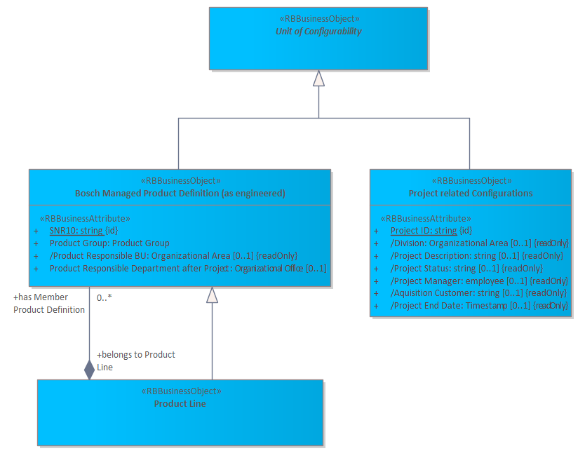
New scenario: Product / Project-Master Data
product centric scenarios
Status Quo: OSLC Configuration Management Concept of the component being abstract and version independant:
In engineering the component relates either to a product, product-line* or a project
Related Use Cases:
Manage Product Master Data
A unit of organization consisting of a set of versioned resources. Components are the units of configurability, and form reusable assets or building blocks.
* see ISO 26580

Slide 12
New scenario: Product-Master Data
product centric scenarios
Open Topics:
Implementation Guideline for Master Data
Will a product inherit all attributes of a component?
How to enhance the data model for company specific Master Data?
Standard for Product-Master Data*
Missing Object-Definitions
Identification
Differentiation:
Clustering → Classification
Engineering Responsibility
Customer (in case of customer-specific products)
Control:
Status (Release, Product Lifecycle)
Utility: general enabling concept
* products include
tangible products (traditional goods) and
intangible products (software and other licensable offerings)
service offerings
Product Lines (abstract variant products)
…on any level of the product structure

Slide 13
Enhanced scenario: Configuration Data
product centric scenarios
Status Quo: OSLC Configuration Management - Concept of the configuration
In engineering configuration relates either to a product, product-line or a project
Related Use Cases:
Manage Product Configurations (e.g. Product versions)
Manage Project Configuration (e.g. for Quality Gates or other milestones)
Open Topics:
Implementation Guideline for Master Data
How to enhance the data model for company specific types of configurations?
Standard enhancement of attributes
Version
Status (Maturity, Release)
(Purpose: e.g. release candidate or special sample for product-configuration or related Milestone for a project-configuration)

Slide 14
Link Index to establish redundant free bidirectional traceability
product centric scenarios
Status Quo: not covered in OSLC existing custom query- or index-based implementations do not scale, have performance issues.
Utility: ensure transparency, traceability as basis to ensure consistency; required by ASPICE
Target: efficiently enable redundant free reverse link* transparency for configuration-aware links considering scalability & performance
Assumption: multiple link indizes required (e.g. for each local friendship network)
Boundary Cond.: enormous amount of links (~trillion) links within a global configuration and across direct parent- and child configurations to be considered
Use Cases: Replicate links to link indizes (e.g. to all usages in friendship network) initial load of link indizes (e.g. for new established friends) get reverse links* for the configuration-context and a set of displayed concept ressources
Open Topics: overall concept (incl. logical architecture; considering true north incl. suspicious linking) interface-specification for the use case (incl. logic, algorithms (?)) Implementation Guideline for Clients and Link Index
* synonym: incoming link

Slide 15
Classification Management
product centric scenarios
Capability: Ability to define and maintain appropriate product hierarchies and clusters in order to provide multiple views on the product portfolio.
Utility: flexible data model enhancement concept for e.g. product-class specific data (e.g. max. pressure for a common rail pump)
Out of Scope: Variant characteristics of a Product line (see Product line engineering)
Use Cases: Define/replicate Class-System (Classes and Characteristics) Classify Leading Object (or Component - e.g. Product or Project) incl. Assign class and maintain characteristics Get classification
Open Topics: overall concept (incl. logical architecture) interface-specification for the use case (incl. logic, algorithms (?)) Implementation Guideline for the Class-system managing system and classification clients
* synonym: incoming link

Slide 16
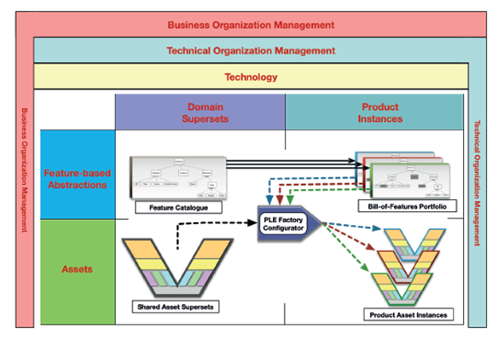
Product Line Engineering (PLE)
product centric scenarios
Capability: Ability to administer product configurations that are offered as individual products and their interdependencies.
Utility: flexible concept to manage variations and variant characteristics of Product lines
Use Cases: Manage Features Define Feature Model/Catalogue Define Variation Points in Models & Configs. Configure Variant (Bill-of-Feature) Check Configuration Derive Variant models (Prod. Asset Inst.) incl. persistance in CMS
Open Topics: overall concept (incl. logical architecture) interface-specification for the use case Implementation Guideline
* ISO 26580 - Software and systems engineering Methods and tools for the feature-based approach to software and systems product line engineering

